Slide 1
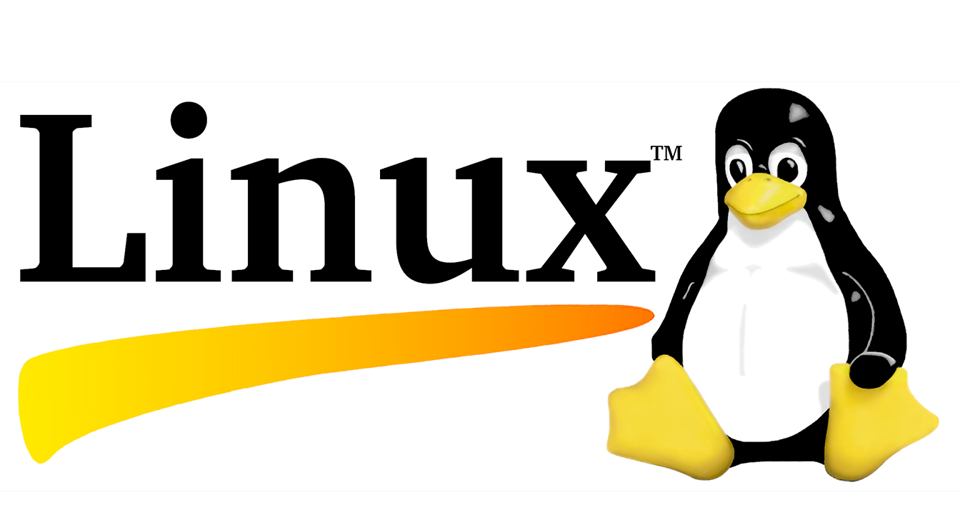
Functions of Umind under Linux system
Insert video playback, take screenshots, share the current page, change background color, turn on the camera, math tools, teaching resource phet, split-screen painting, desktop, switch between dark and light modes.

Slide 2
Linux system
Ubuntu
Astra
Debian
Linux-compatible OS
This operating system supports a Linux-compatible environment and can run mainstream Linux distributions such as Astra,Rosa,Ubuntu, Debian, and RedHat
RedHat
Rosa

Slide 3
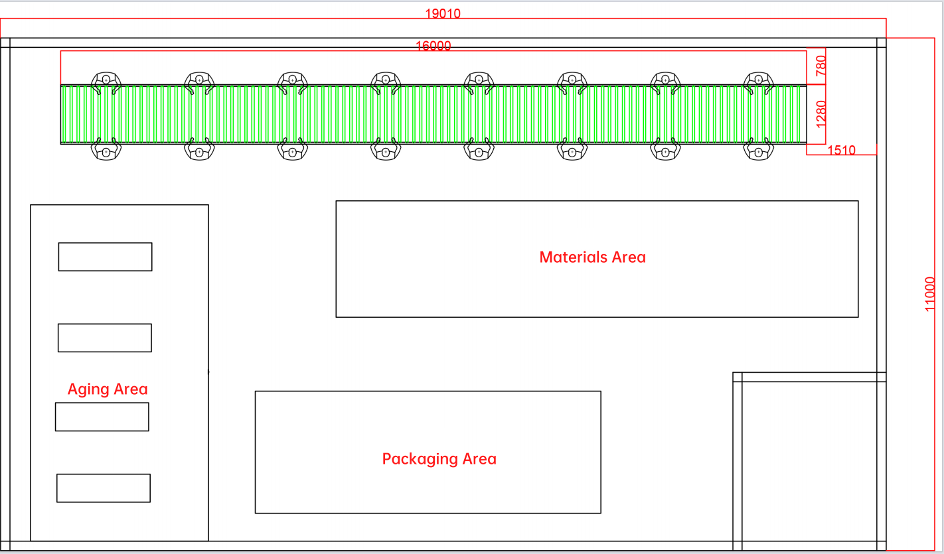
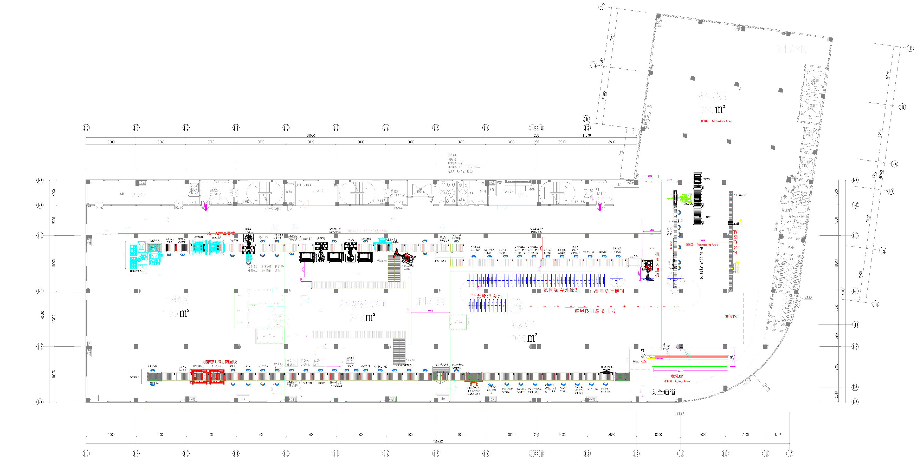
Production line
Production line 3
Production line 1
Production line 3

Slide 4
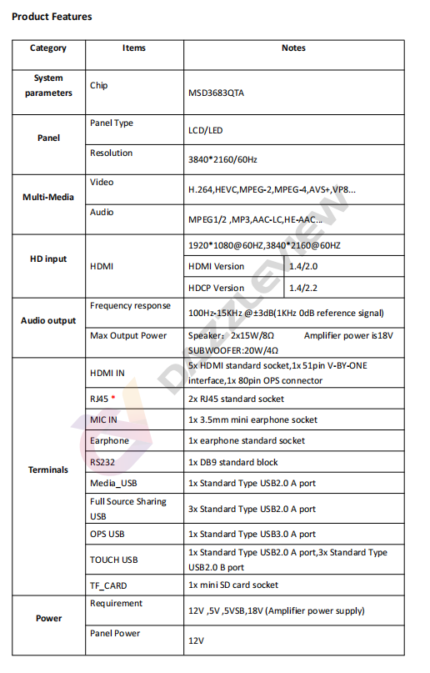
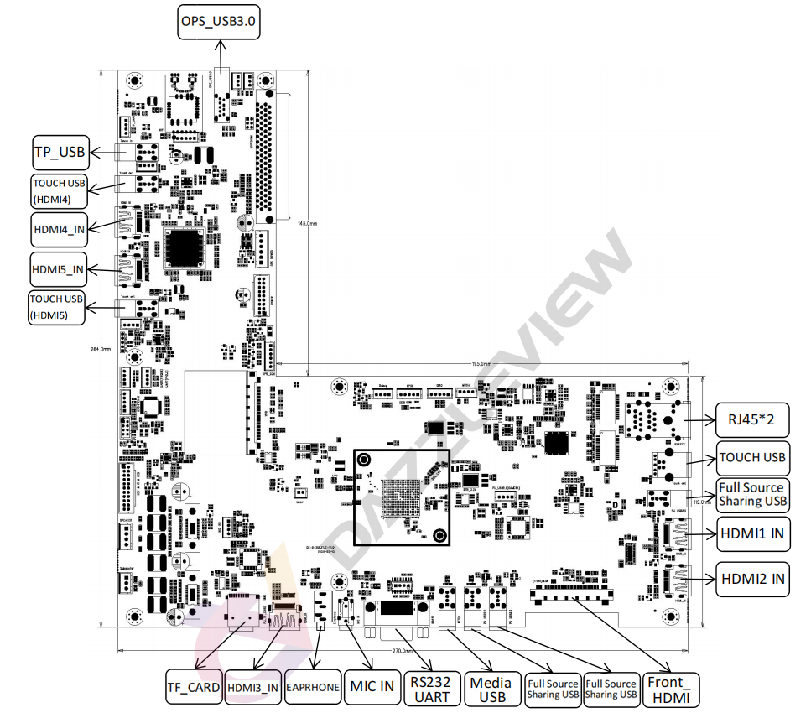
Mainboard
Mainboard port

Slide 5
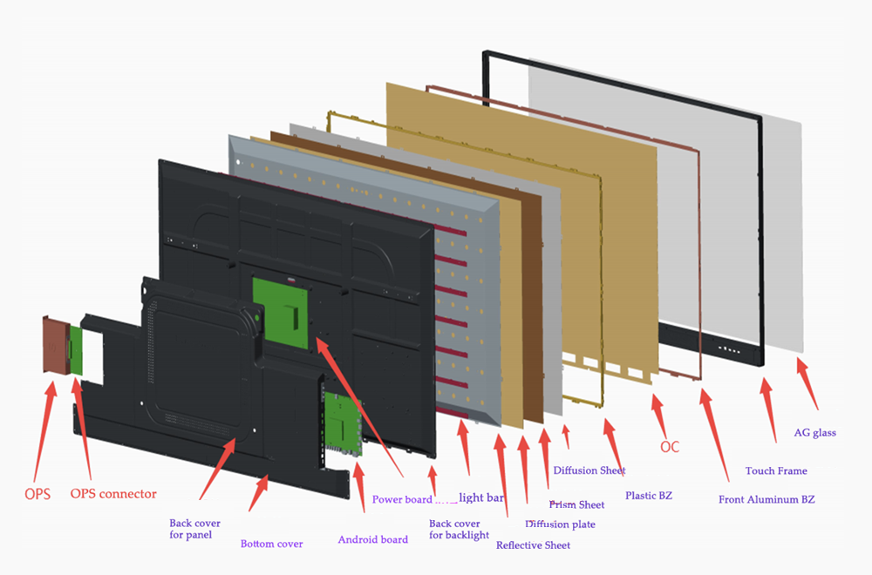
IFPD CKD Parts

Slide 6
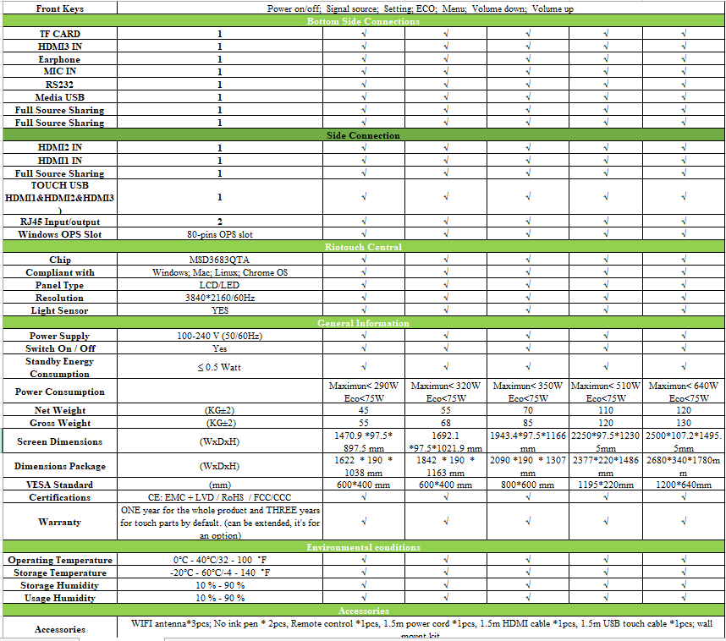
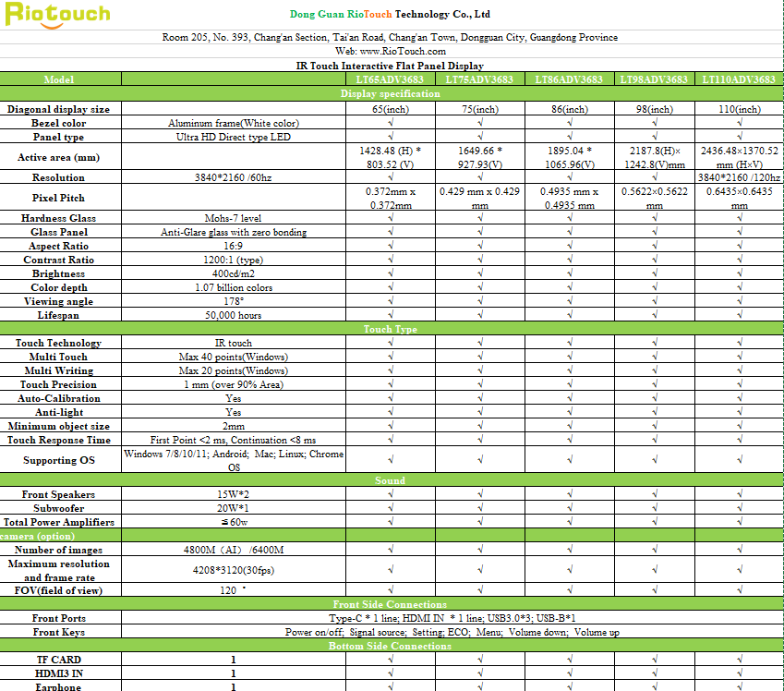
Pecification sheet

